Slide 1

Predicting customer buying behaviour
23/05/2025

Slide 2
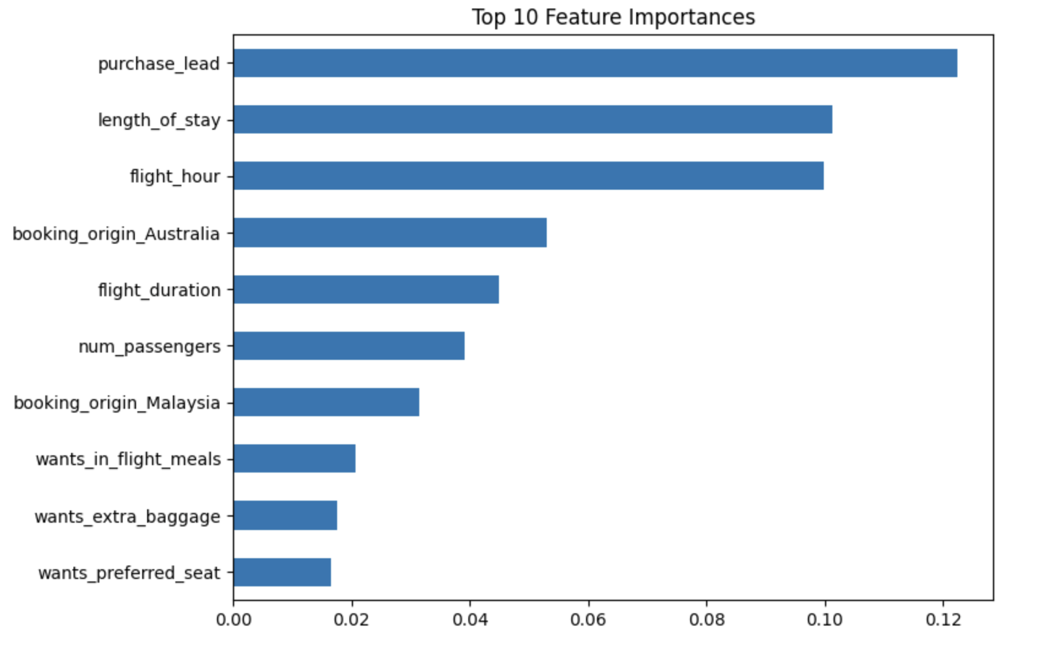
predictive model to understand factors that influence buying behaviour
We have trained the data set with Random forest classifier model and received
ACCURACY: 85.07
AUC score: 0.7796
purchase_lead
length_of_stay
flight _hour
booking_origin_Australia
flight_duration
are the top 5 features which influence
Customer buying behavior
AUC score after testing is very good, can use other models to experiment

